Slide 1
Using an AI when writing
Henrik Galligani Ræder

Slide 2
Using an AI when writing
Some pros
Save time
Overcome writer's block
Understands myriad of languages
Some cons
Black box
Quality
Bias
Plagiarism
Downtime
Nuance

Slide 3
Using an AI when writing: Two warnings
The AI writes convincingly when it’s wrong
Writing is an effective form of learning

Slide 4
Using an AI for feedback
Traditional feedback process
AI improved feedback process
Supervisor
Supervisor
AI
PhD candidate
PhD candidate

Slide 5
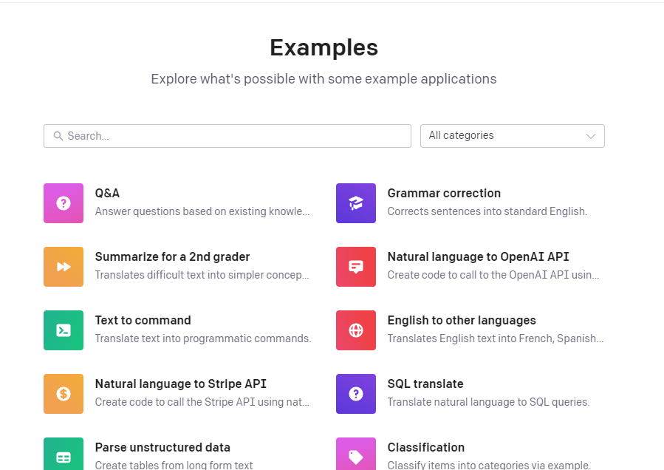
Using an AI for checking grammar
Pretrained models specialized in grammar check
https://beta.openai.com/examples

Slide 6
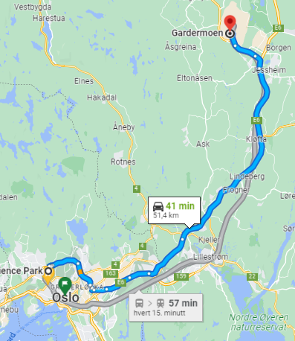
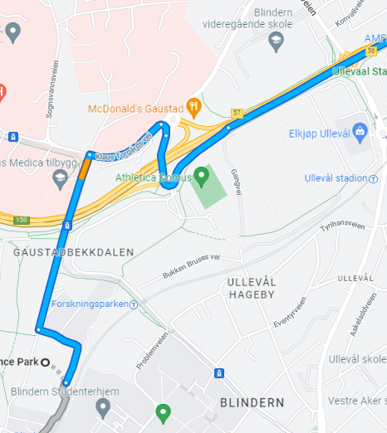
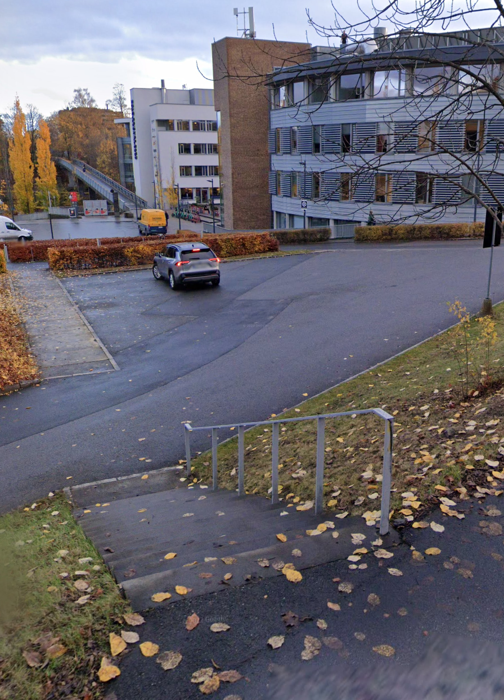
Using an AI for writing a text
Overall structure → Chapter/segment structure → Paragraphs of text

Slide 7
Using an AI for writing a text cont.
Some useful terms when using an AI for generating text
Outline
Continue
Expand
NB! The documentation is worth reading!
The Complete Guide to AI Text Generators for Creators (How They Work, Limitations, and How to Use Them):
https://castos.com/ai-text-generators/

Slide 8
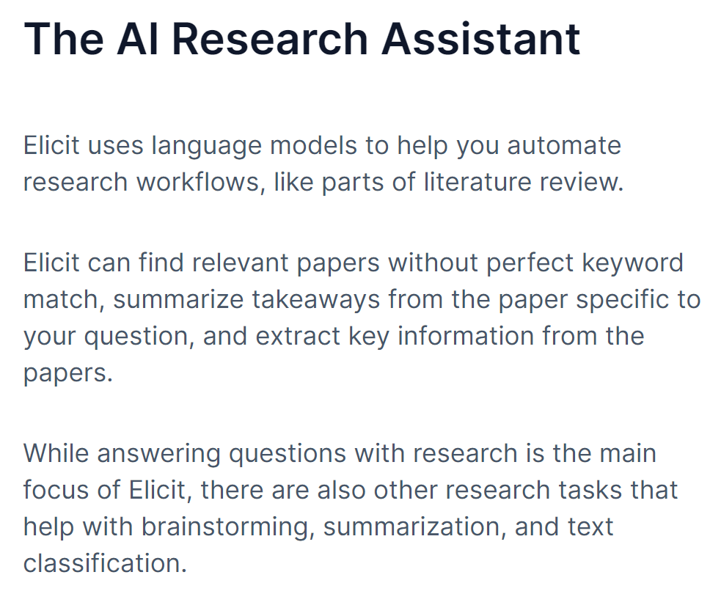
Other AI resources
University Library can help with AI driven systematic literature search
ASReview
Open source software for systematic reviewing
Zotero
Plugins available for AI driven literature search
Grammarly
AI driven grammar check. Free and Premium versions available
Other:
https://renaissancerachel.com/best-ai-writing-tools/
https://elicit.org/

