Slide 1
Metadatastandards for Fair@UiO
Qualifair event May 5th 2022
Elin Stangeland, The University of Oslo Library

Slide 2
Agenda
Metadata introduction
Examples of metadata in use
The Fair@UiO approach
Our process
Challenges
The UiO standard
Qualifair contributions
If time – what is happening next

Slide 3
Metadata
Metadata or “data about data” are information we create, store, and share to describe things.
This allows us to interact with these things to obtain the knowledge we need.
Descriptive metadata -- is structured data about anything that can be named, such as Web pages, books, journal articles, images, songs, products, processes, people (and their activities), research data, concepts, and services.
Sources: NISO, Jenn Riley: https://www.niso.org/publications/understanding-metadata-2017
Dublin Core: https://www.dublincore.org/resources/metadata-basics/

Slide 4
Types of metadata
https://www.niso.org/publications/understanding-metadata-2017

Slide 5
Why do we need metadata?
Discovery
Aid in identification or understanding of a resource
Interoperability
Digital object management
Preservation
Navigation within parts of items
A huge help when making data FAIR!
https://www.niso.org/publications/understanding-metadata-2017

Slide 7
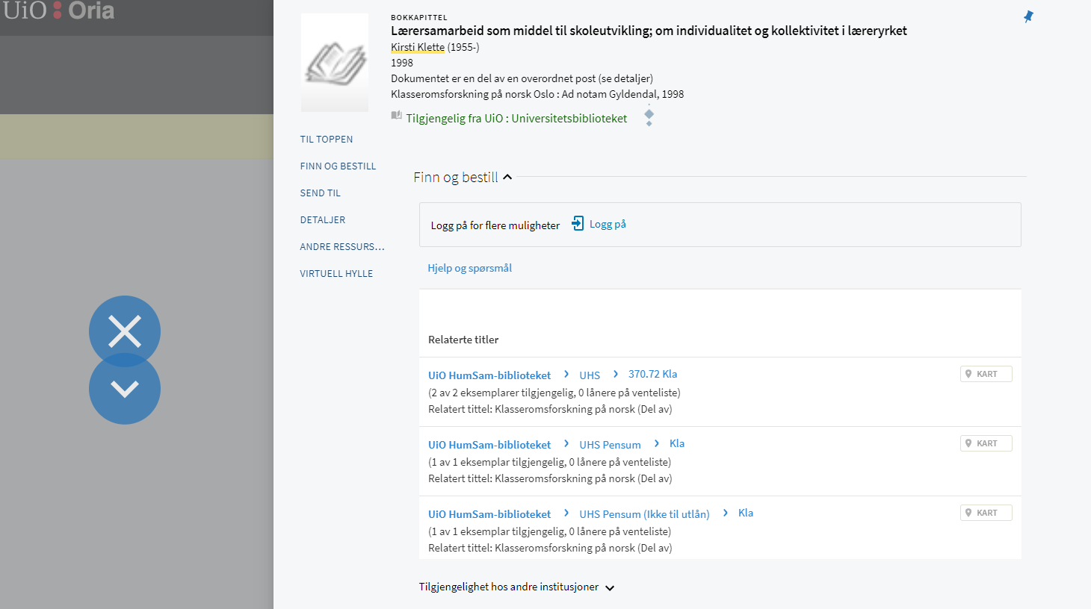

Slide 8
Lærersamarbeid som middel til skoleutvikling; om individualitet og kollektivitet i læreryrket / Kirsti Klette Klette, Kirsti (1955-)1998
*ldr 00628caa a2200181 c 4500
*001 990406077124702201
*005 20180601092139.0
*007 ta
*008 150915s1998 xx#|||||||||||000|u|und|d
*035## $a(NO-TrBIB)040607712
*035## $a(NO-TrBIB)040607712
*040## $aNO-TrBIB $bnob $ekatreg
*1001# $aKlette, Kirsti $d1955- $0(NO-TrBIB)90799277
*24510 $aLærersamarbeid som middel til skoleutvikling; om individualitet og kollektivitet i læreryrket $cKirsti Klette
*260## $c1998
*300## $as. 157-176
*7730# $tKlasseromsforskning på norsk $dOslo : Ad notam Gyldendal, 1998 $z8241708785 $w999810038774702201
*901## $a80
Source: https://marcpresentation.bibs.aws.unit.no/?mms_id=990406077124702201

Slide 9
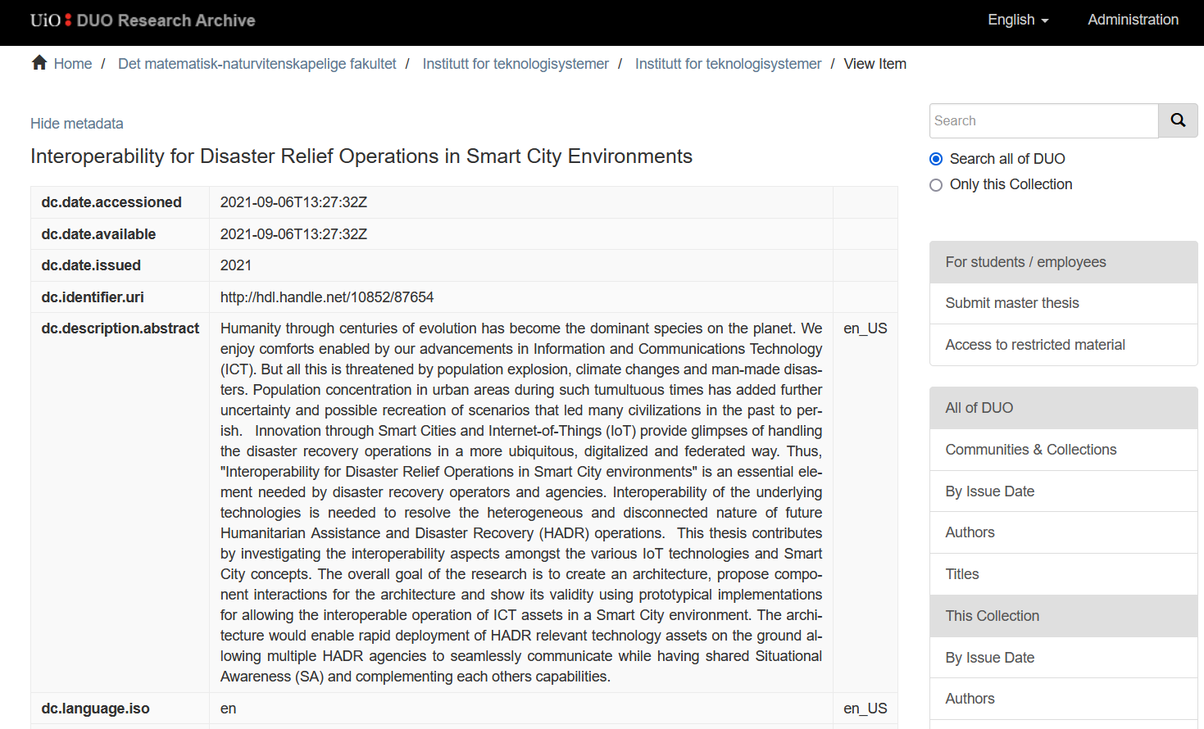

Slide 10
Dublin Core Metadata Element Set
01. Contributor – “An entity responsible for making contributions to the resource.”
02. Coverage – “The spatial or temporal topic of the resource, the spatial applicability of the resource, or the jurisdiction under which the resource is relevant.”
03. Creator – “An entity primarily responsible for making the resource.”
04. Date – “A point or period of time associated with an event in the lifecycle of the resource.”
05. Description – “An account of the resource.”
06. Format – “The file format, physical medium, or dimensions of the resource.”
07. Identifier – “An unambiguous reference to the resource within a given context.”
08. Language – “A language of the resource.”
09. Publisher – “An entity responsible for making the resource available.”
10. Relation – “A related resource.”
11. Rights – “Information about rights held in and over the resource.”
12. Source – “A related resource from which the described resource is derived.”
13. Subject – “The topic of the resource.”
14. Title – “A name given to the resource.”
15. Type – “The nature or genre of the resource.”
https://www.dublincore.org/specifications/dublin-core/dcmi-terms/

Slide 11
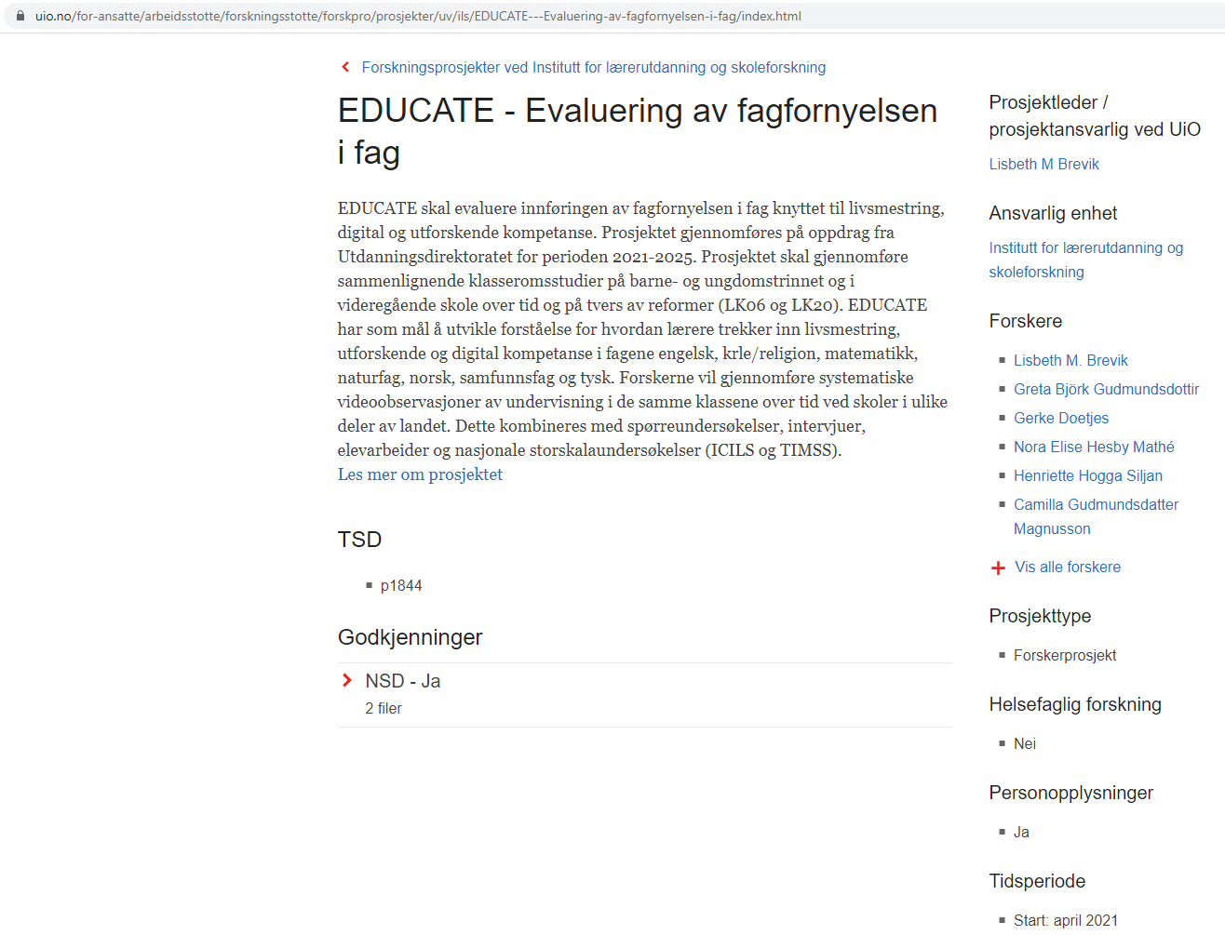
Notes:
Forskpro – project metadata

Slide 12
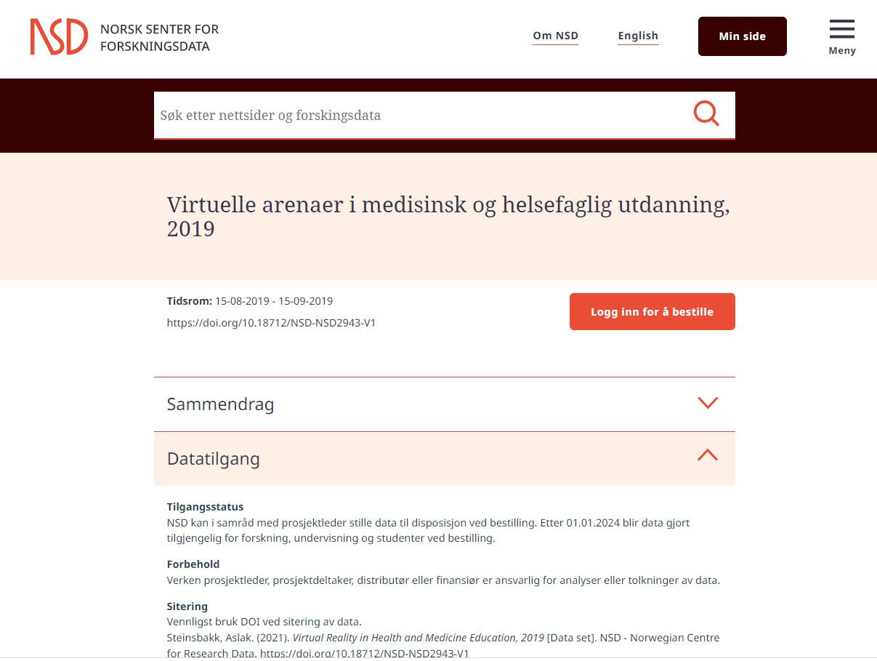
Source: https://doi.org/10.18712/NSD-NSD2943-V1
Notes:
An international standard for describing the data produced by observational methods in the social, behavioural, economic, and health sciences
Expressed in XML
Supports the entire research data lifecycle:
For a single data set: DDI Codebook (DDI-C)
For a longitudinal, linked and other complex datasets: DDI Lifecycle (DDI-L)
Common fields include: Title, Alternate Title, Principal Investigator, Funding, Bibliographic Citation, Series Information, Summary, Subject Terms, Geographic Coverage, Time Period, Date of Collection, Unit of Observation, Universe, Data Type, Sampling, Weights, Mode of Collection, Response Rates, Extent of Processing, Restrictions, Version History
For interdisciplinary research soon is coming DDI - Cross Domain Integration (DDI-CDI)
https://ddialliance.org/products/overview-of-current-products
https://www.cessda.eu/Training/Training-Resources/Library/Data-Management-Expert-Guide/2.-Organise-Document/Documentation-and-metadata
From RDM course

Slide 13
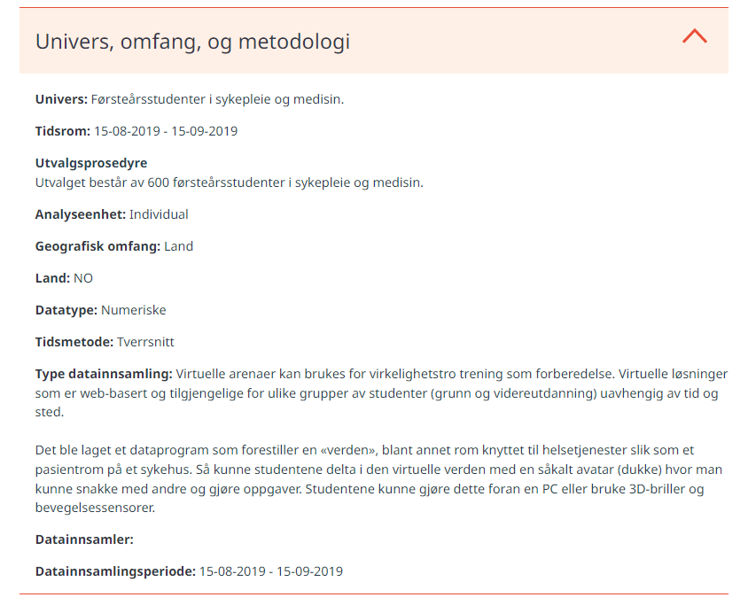

Slide 14
FAIR@UiO project
Project start: November 2020
Collaboration between USIT, UB, administration (and researchers/local data managers with domain knowledge)
Create a platform/technical solution enabling tagging research data with metadata/documentation
Selected a tool from IBM – Spectrum discovery
Metadata should be collected automatically when possible, filled out manually only once
Not an archive, but making archiving easier

Slide 15
What we hope to achieve
Searchable metadata
Improved structure in large datasets
Dynamic storage: move inactive data to cheaper storage solutions automatically
Project level metadata collected automatically from NSD, Cristin, etc.
Granulated access to data
Increased reuse of data, more interdisciplinary collaboration

Slide 16
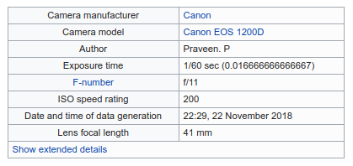
FAIR@UiO internal metadata
Internal metadata
Technical and administrative metadata extracted from the files
Bitsums, date information, file format details
Extracted metadata
Exchangeable image file format
FFMPEG
Create own standard
Exif sample metadata. Source: Praveenp, CC BY-SA 3.0 <https://creativecommons.org/licenses/by-sa/3.0>, via Wikimedia Commons

Slide 17
The UiO library team
Liv Brenna
Kristin Charlotte
Carlsson
Lars Alvik
Dan Michael Heggø
Elin Stangeland

Slide 18
Our process
Verified best practice for dataset metadata
Reviewed standards
Selected Dataverse standard to build upon
Adapted to use for dynamic data
Mapped standards to ours

Slide 19
Notes:
DataCite: https://schema.datacite.org/
Dublin Core Metadata Terms: https://www.dublincore.org/specifications/dublin-core/dcmi-terms/
MODS: http://www.loc.gov/standards/mods/mods-outline-3-5.html
OpenAire: https://guidelines.openaire.eu/en/latest/data/index.html
DDI: https://ddialliance.org/
Schema.org: https://schema.org/Dataset
Dataverse: https://docs.google.com/spreadsheets/d/13HP-jI_cwLDHBetn9UKTREPJ_F4iHdAvhjmlvmYdSSw/edit#gid=0

Slide 20
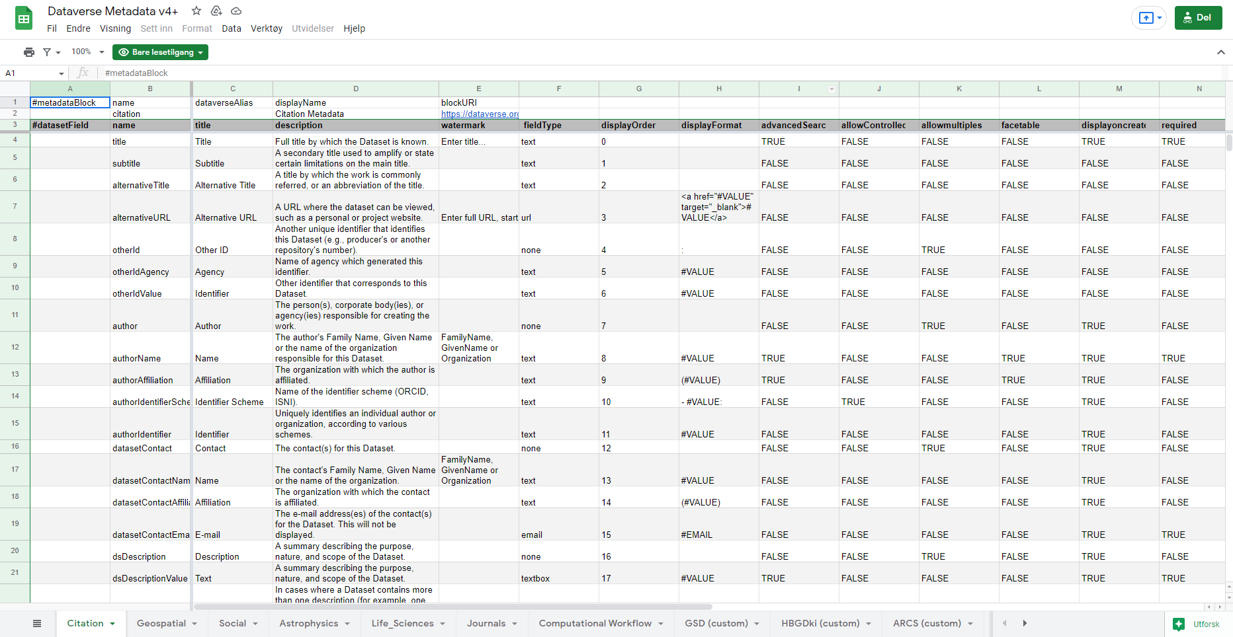
Notes:
The dataverse metadata standard – v.4 – which we built upon
https://docs.google.com/spreadsheets/d/13HP-jI_cwLDHBetn9UKTREPJ_F4iHdAvhjmlvmYdSSw/edit#gid=0

Slide 21
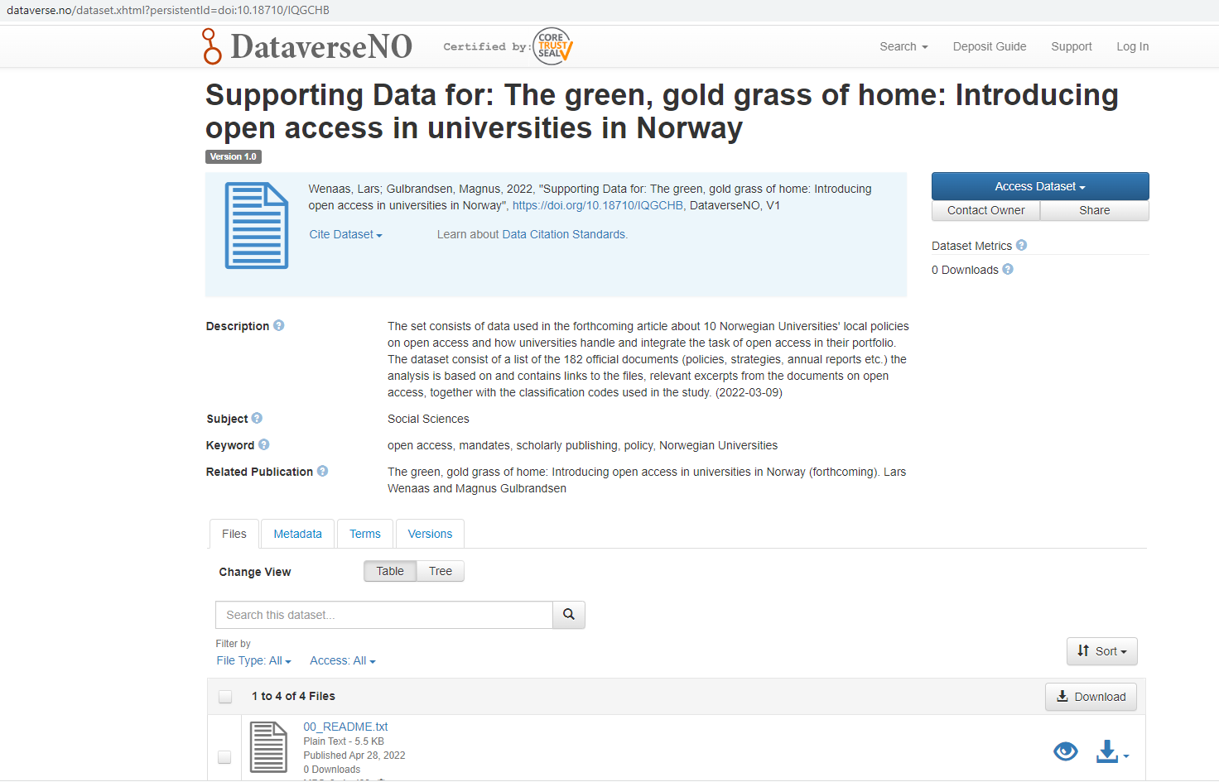
Source: doi.org/10.18710/IQGCHB

Slide 22
Challenges working with dynamic data
Everything is changeable
Which dates do we need?
Versioning?
To PID or not to PID?

Slide 23
Fair@UiO open metadata - mandatory
Field | Description
Description | A summary describing the purpose, nature, and scope of the dataset.
Subject | Domain-specific Subject Categories that are topically relevant to the Dataset.
Title | Full title by which the Dataset is known.
Title type | Type of Title e.g. main title or alternative title
Creator name | Name of the person(s), corporate body(ies), or agency(ies) responsible for the dataset.
Contact email | E-mail address(es) of the contact(s) for the dataset.

Slide 24
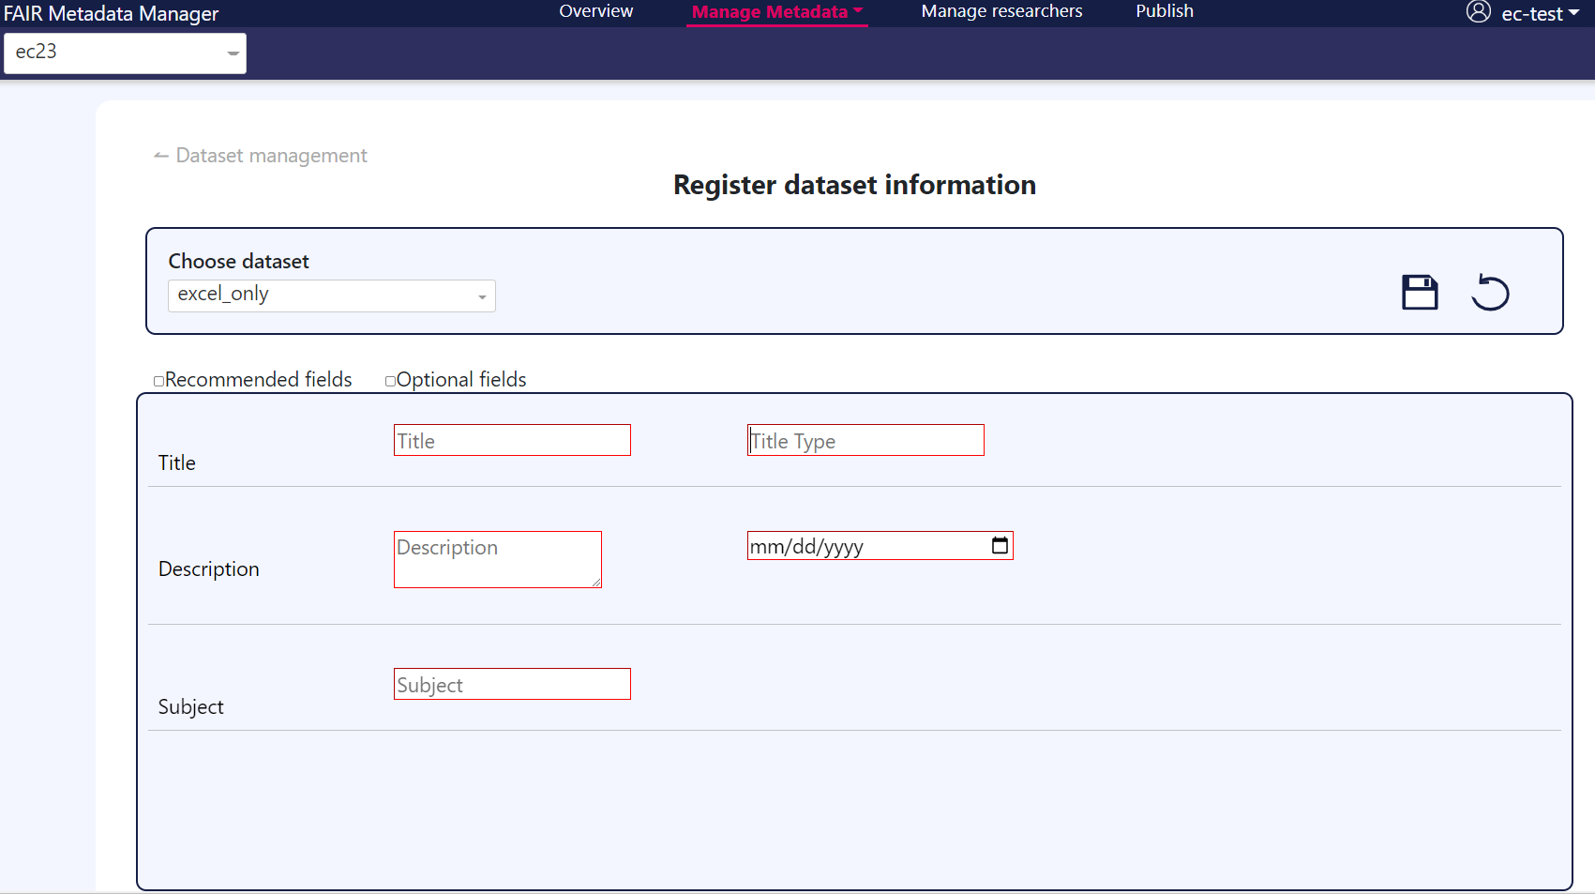
Notes:
Fra test server – så blir ikke 100% sånn.

Slide 25
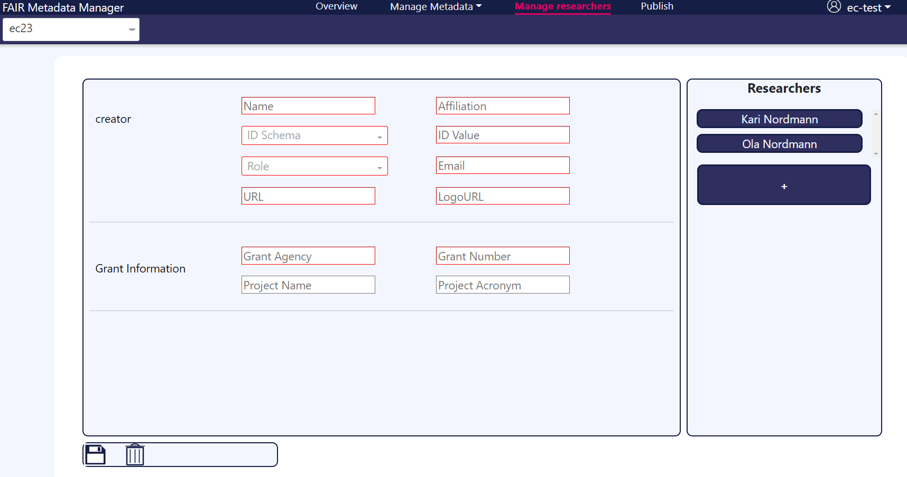
Roles:
Author (obligatorisk)
Dataset contact (obligatorisk)
Publisher
Producer
Distributor
Depositor
Principal investigator

Slide 26
Fair@UiO open metadata - Recommended
Field | Description
Keyword | Key terms that describe important aspects of the Dataset.
Publication | Information about publications related to the dataset. Citation
ID type | The type of digital identifier used for this publication (e.g., Digital Object Identifier (DOI)).
ID Number | The identifier for the selected ID type.
URL | Link to the publication web page (e.g., journal article page, archive record page, or other), if PID is not available.
Language | Language of the dataset
Grant Agency | Grant Number Agency (F.ex. EU, NFR)
Grant Number | The grant or contract number of the project that sponsored the effort.
Project Name | The name of the project
Project Acronym | The acronym of the project
Software name | Information about the software used to generate the Dataset.
Software version | Version of the software used to generate the Dataset.
Creator affiliation | The organization with which the person(s), corporate body(ies), or agency(ies) is affiliated.
Creator IDScheme | Name of the identifier scheme (e.g. Orcid)
Creator IDvalue | The ID that identifies an individual person(s), corporate body(ies), or agency(ies), according to various schemes.

Slide 27
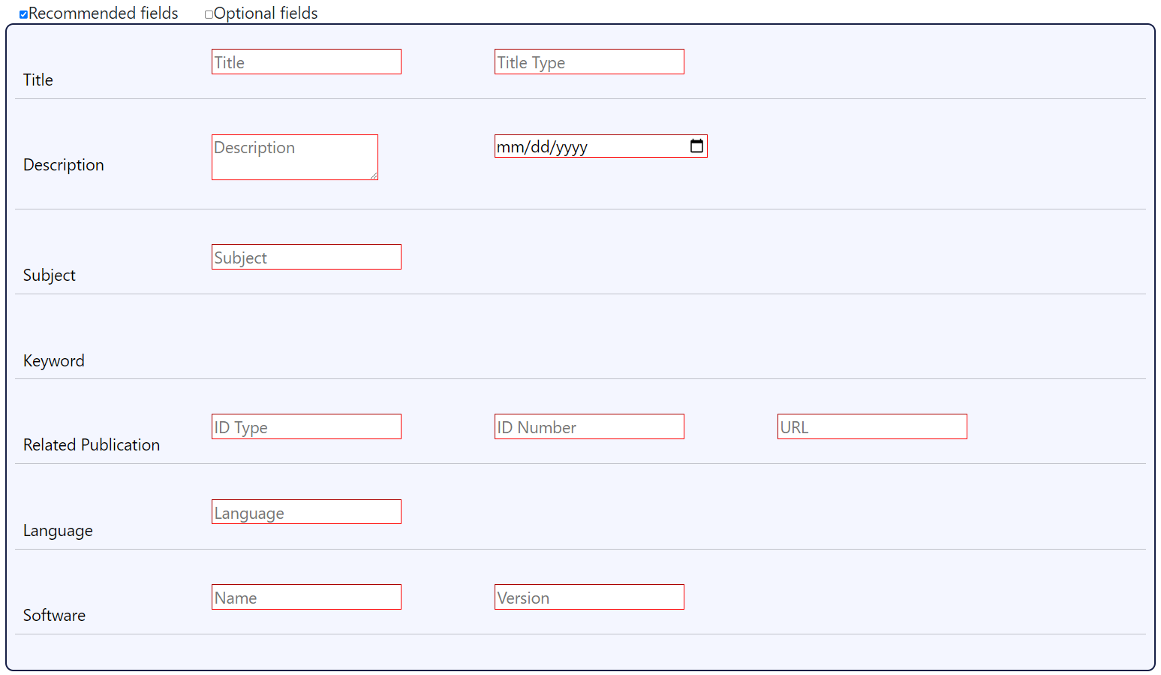

Slide 28
Datoer
Field | Description
dateOfDeposit | Date that the Dataset was uploaded to UiO storage
dateOfCollectionStart | Date when the data collection started.
dateOfCollectionEnd | Date when the data collection ended.
MetadataCreationDate | Date when metadata for dataset were created/published (in published metadata only)
datasetVersionDate | Date when a version of a dataset were created

Slide 29
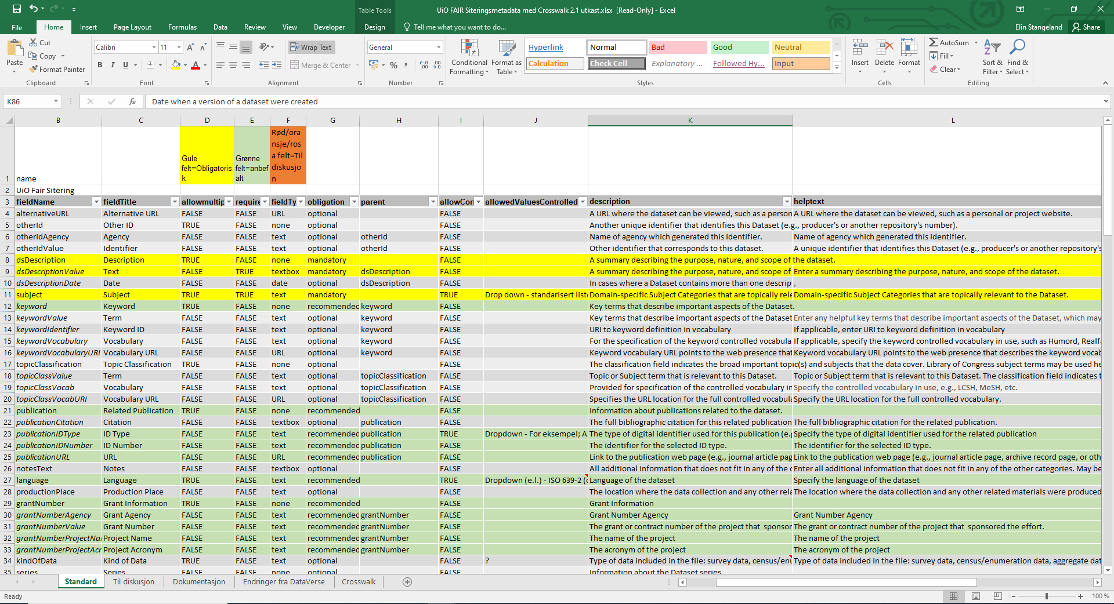
Notes:
This part of our spreadsheet –
Yellow is mandatory
Green recommended
Grey optional – as you can see quite a lot of those – we’ll come back to these if you want to…
Orange – needs more work

Slide 30
Qualifair contributions
Test the upcoming releases
Feed back on errors
Things that does not work
Could be organised better
Further down the line
Consider how (if useful) to move towards more discipline specific standards
Define use cases/scenarios
DDI?
The Qualitative Data Exchange Schema (QuDEx)
…

Slide 31
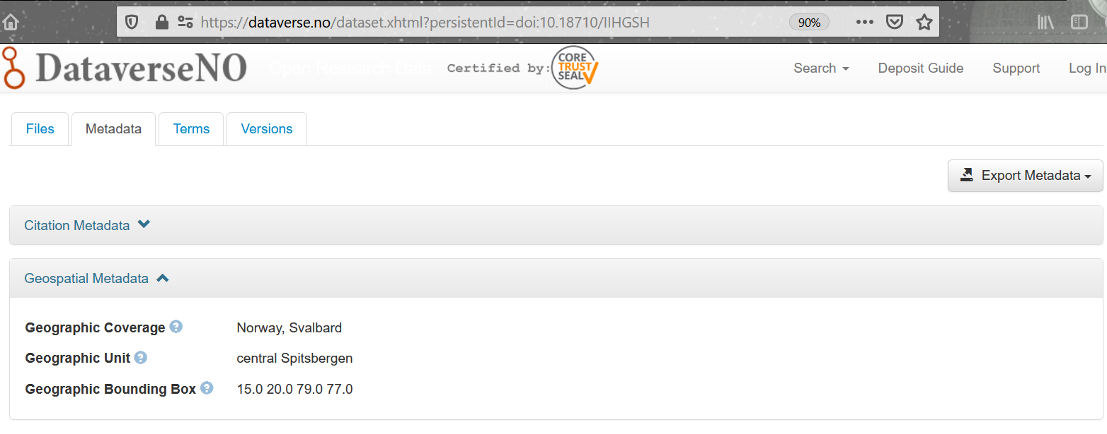
Discipline specific metadata: https://rd-alliance.github.io/metadata-directory/standards/​

Slide 32
Questions?
Project details: https://www.usit.uio.no/prosjekter/fair-uio/
Contact: elin.stangeland@ub.uio.no

