Slide 1
Eye-tracking in Special needs Education Research: Thinking out of the box
Implementation and Examples

Slide 2
Main domains
Reading and Mathematics
Attentional disengagement, joint attention, and social scene perception
Hearing impairments
Intellectual disabilities
Emotional Status
Multimedia learning and Educational computer games
Teachers’ attention
Eye-tracking as a tool : Simulated thalamic visual prostheses and pure alexia

Slide 3
Reading and Mathematics

Slide 4
Keith Rayner
Rayner, K. (1998). Eye Movements in Reading and Information Processing: 20 Years of Research. Psychological Bulletin, 124, 372–422
Rayner, K. (2009). Eye movements and attention in reading, scene perception, and visual search. The Quarterly Journal of Experimental Psychology, 62, 1457–1506

Slide 5
Parafoveal Processing and Perceptual Span Yan et al. (2013). Parafoveal processing efficiency in rapid automatized naming: A comparison between Chinese normal and dyslexic children. Journal of Experimental Child Psychology
Do children with dyslexia suffer less than normal readers from removing parafoveal preview?
Children with and without dyslexia Grade 5

Slide 6
Children with dyslexia extract less parafoveal information than control children

Slide 7
Eye-voice span (Eye-voice lead) de Luca et al. (2013). The eye-voice lead during oral reading in developmental dyslexia. Frontiers in Human Neuroscience. doi: 10.3389/fnhum.2013.00696
The eye typically leads over voice position
Comparing children with dyslexia and control readers
Passage reading

Slide 8
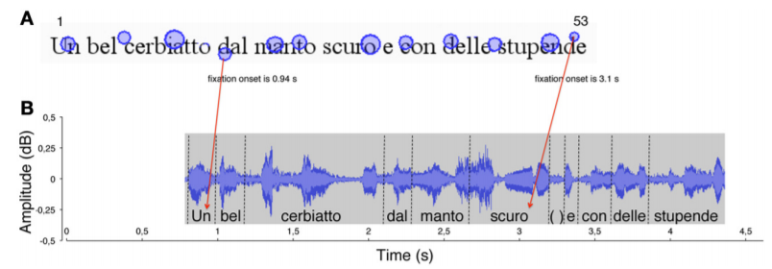
Eye-voice span was significantly smaller in dyslexic than control readers

Slide 9
Eye-hand span
Penttinen et al. (2014). Reading ahead: Adult music students’ eye movements in temporally controlled performances of a children’s song. International Journal of Music Education, 33, 36-50

Slide 10
Math Anxiety and Performance Hunt et al. (2015). Exploring the Relationship Between Mathematics Anxiety and Performance: An Eye‐Tracking Approach. Applied Cognitive Psychology, 29, 226–231
Relationship between math anxiety and arithmetic performance
Performance on an arithmetic verification task

Slide 11
Specific digit fixations, dwell time, saccades, and regressions all significantly predicted response time
Positive correlations between math anxiety and fixations
Utility of an eye‐tracking approach in studying arithmetic performance
+++++
23+29= 52
Response
+++++
Carry operation or not required

Slide 12
Strategies van’t Noordende et al. (2016). Number line estimation strategies in children with mathematical learning difficulties measured by eye tracking. Psychological Research, 80,368–378.
Estimation strategies in children with MLD children and without
Number line estimation was measured using a 0–100 and a 0–1000 number-to-position task

Slide 13
0-33, if target number less than 33, etc
Groups differed in their estimation strategies.
Children with MLD attend to different features of the number line than children without math difficulties
Are less capable of adapting their estimation strategies to the numbers to be estimated and of effectively using reference points on the number line
0 _ _ _...._ _ _ …_ _ _100
Mouse click to the estimated position
0 _ _ _...._ _ _ …_ _ _1000

Slide 14
Mathematical Representations Bolden et al. (2015). How young children view mathematical representations: a study using eye-tracking technology. Educational Research, 57, 59–79
How young children view and interpret mathematical representations of multiplication
Children with MLD
Slides presenting a symbolic and a picture representation of multiplication problems

Slide 15
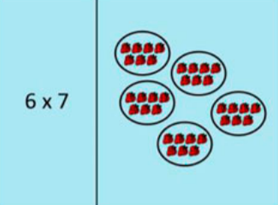
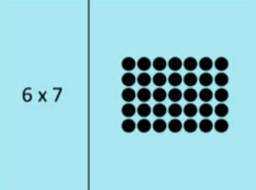
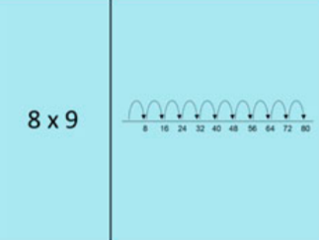
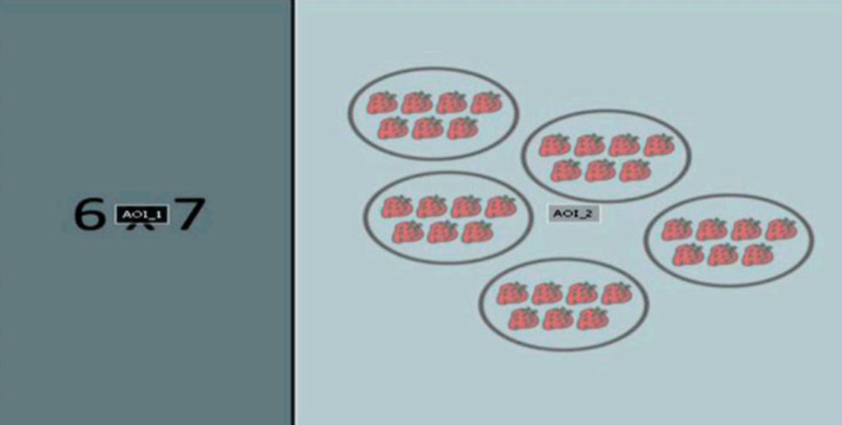
groups
array
number line

Slide 16
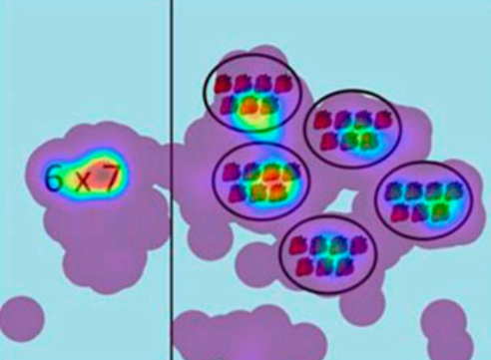
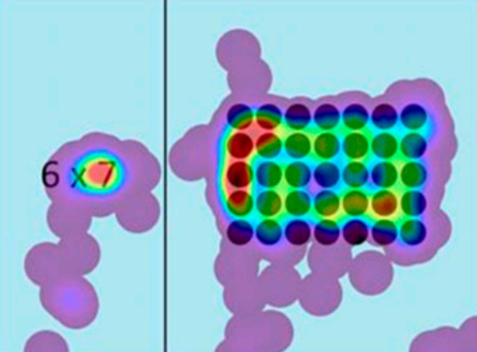
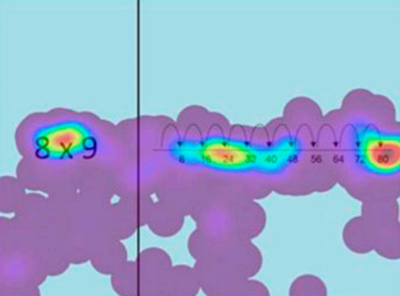
Number line representation was less successful than the others in promoting multiplicative thinking in children

Slide 17
Attentional disengagement, joint attention, and social scene perception

Slide 18
Joint attention and attentional disengagement in Infancy Thorup et al. (2018). Reduced Alternating Gaze During Social Interaction in Infancy is Associated with Elevated Symptoms of Autism in Toddlerhood. Journal of Abnormal Child Psychology, 46, 1547–1561
Children with Autism Spectrum Disorder (ASD)
initiate less joint attention
Influence of attention disengagement
Eye tracking in live setting
10-months old HR and LR infants
Tasks:
Initiate Joint Attention task→ altering gaze
Attention Disengagement Task
Follow up after 8 months: ASD symptoms and gestural IJA (pointing/showing)

Slide 19
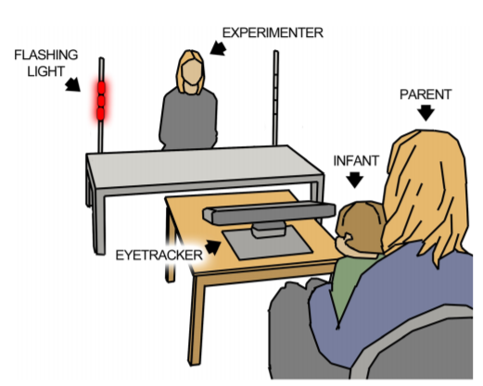

Slide 21
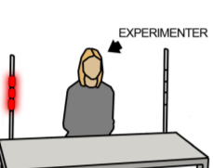
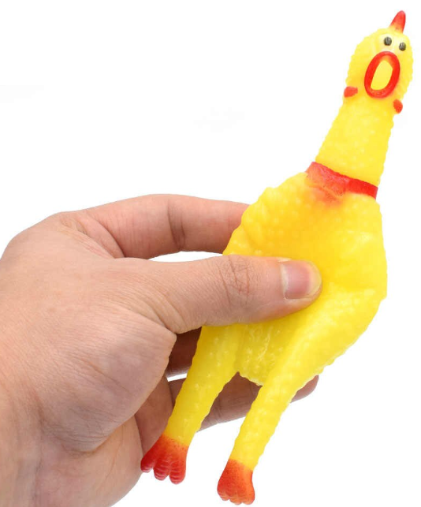
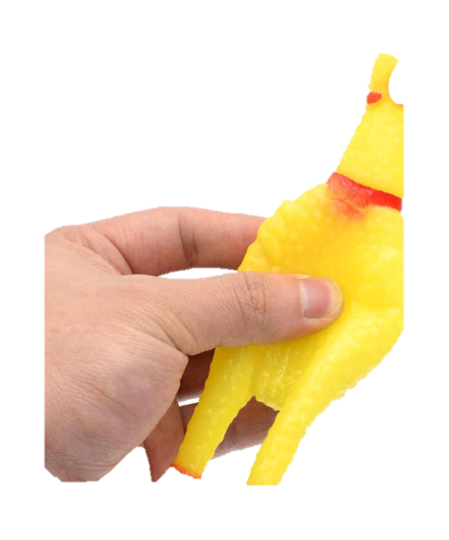

Slide 23
HR engage less in alternating gaze during interaction with an adult
Less alternating gaze at 10 months was associated with more social ASD symptoms and less showing and pointing at 18 months

Slide 24
Attentional Disengagement in older children Sabatos-DeVito et al. (2016). Eye Tracking Reveals Impaired Attentional Disengagement Associated with Sensory Response Patterns in Children with Autism. J Autism Dev Disord, 46, 1319–1333
The impact of distractor salience and temporal overlap on the ability to disengage and orient attention
Children with ASD, DD, TD (4-13 years)
Gap-overlap paradigm
“Look at the pictures on the computer screen”

Slide 25
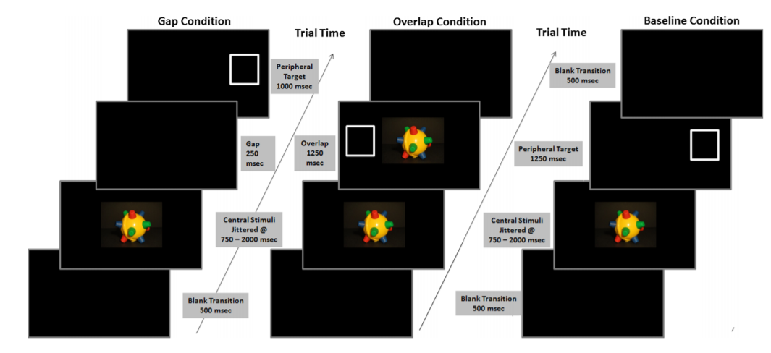
Dynamic + Auditory
Dynamic
Static
Impaired disengagement and orienting accuracy in ASD
Disengagement was impaired across all groups during temporal overlap for dynamic than static stimuli
Only ASD children showed slower disengagement from multimodal relative to unimodal dynamic stimuli

Slide 26
Social scene perception Frost-Karlsson et al. (2019). Social scene perception in autism spectrum disorder: An eye-tracking and pupillometric study. Journal of Clinical and Experimental Neuropsychology ,41, 1024–1032
Investigate the processing of social and non-social scenes ASD and nonASD (other developmental disorders) 12-20 years old
Eye tracking and pupillometry measures

Slide 27
12s
Participants with autism did not show greater pupillary response to images with a human
Participants with autism were slower to fixate on social elements in the social scenes, and this latency metric correlated with clinical measures of poor social functioning
No group differences in gaze duration in social AOIs→ static images?
“Look freely at the photographs presented on the monitor”

Slide 28
Nature of social stimuli Chevallier et al. (2015). Measuring social attention and motivation in autism spectrum disorder using eye‐tracking: Stimulus type matters. Autism Res. , 620–628
Ecological nature of the social stimuli would affect participants' social attention, with gaze behavior during more naturalistic scenes being most predictive of ASD vs. typical development
ASD vs TD 6-17 years old
Viewing task

Slide 29
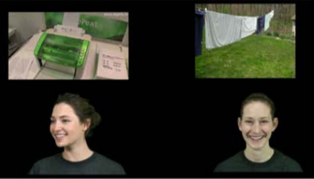
Static
Dynamic
Dynamic/interactive
Three‐way interaction between Task, Social vs. Object Stimuli, and Diagnosis: This interaction was driven by group differences on one task only—the Interactive task
The ecological relevance of social stimuli is an important factor to consider for eye‐tracking studies aiming to measure social attention and motivation in ASD

Slide 30
Hearing impairments

Slide 31
Speech Processing McMurray et al. (2017). Waiting for lexical access: Cochlear implants or severely degraded input lead listeners to process speech less incrementally. Cognition, 169, 147-164.
Real-time lexical competition
Adolescences CI users and NH
Visual World Paradigm with phonological competitors

Slide 32
Target
wizard
Onset competitor
whistle
CI users showed a large delay in fixating any object
Less competition from onset competitors
Increased competition from rhyme competitors
Waiting to begin lexical access until substantial information has accumulated
Rhyme competitor
lizard
Unrelated
bottle

Slide 33
Sentence Comprehension Wendt et al. (2015). How Hearing Impairment Affects Sentence Comprehension: Using Eye Fixations to Investigate the Duration of Speech Processing. Trends in Hearing, 19, 118.
Extent to which hearing impairment influences the duration of sentence processing
Adults with and without hearing aid
Eye fixations recorded while the participant listens to a sentence
Type of sentences:
Subject- Verb- Object structure (SVO)
Object-Verb- Subject structure (OVS)
Ambiguous Object-Verb- Subject structure (ambOVS)

Slide 34
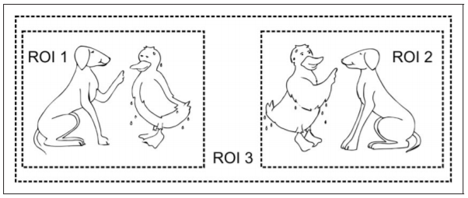
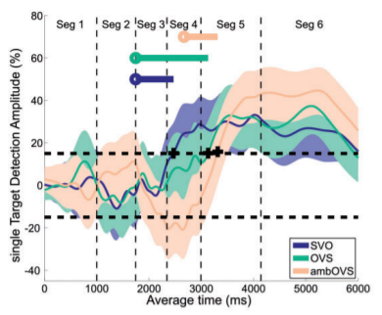
The wet duck reprimands the loyal dog.
Participants with hearing impairment spent more time processing sentences

Slide 35
Listening Effort Steel et al. (2015). Binaural Fusion and Listening Effort in Children Who Use Bilateral Cochlear Implants: A Psychoacoustic and Pupillometric Study. PlosOne, doi: 10.1371/journal.pone.0117611
Binaural Fusion Assessment
Deaf children with cochlear implants and 24 peers with normal hearing
Pupillary changes were recorded to measure listening effort

Slide 36
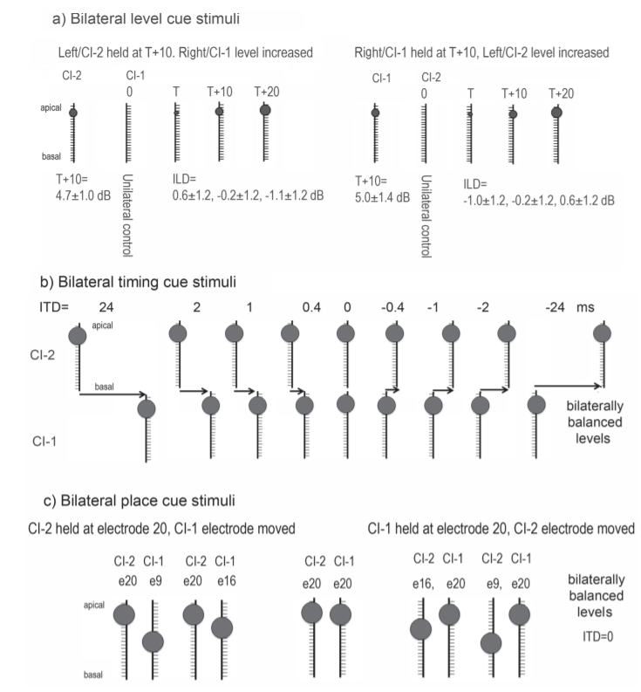
Task:
Press as fast as possible on the single circle if you hear 1 sound and on the pair of circles, if you hear 2 sounds.
Children with CI had greater changes in pupil diameter than their NH peers
As binaural fusion decreased, pupil size increased→ listening effort

Slide 37
Van Engen & McLaoughlin (2018). Eyes and ears: Using eye tracking and pupillometry to understand challenges to speech recognition. Hearing Research, 369, 56-66.

Slide 38
Intellectual disabilities

Slide 39
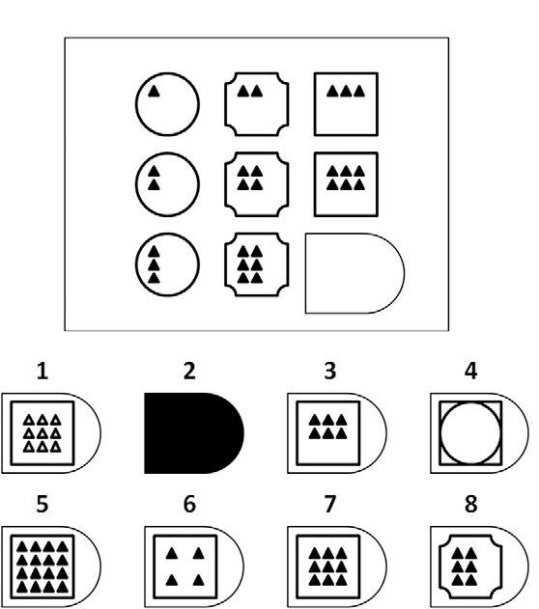
Strategies Vakil & Lifshitz-Zehavi, (2012). Solving the Raven Progressive Matrices by adults with intellectual disability with/without Down syndrome: Different cognitive patterns as indicated by eye-movements. Research in Developmental Disabilities, 33,645-654
Qualitative analysis of information processing in Raven matrices performance
ID vs DS vs TD participants
TD group spent more time on the matrices before shifting to the options, than the two ID groups
TD group made significantly less switches from one rejoins to another, than the ID groups.
Constructive matching vs Response elimination strategies
Eye movements critical in populations which have difficulties explicitly expressing the strategy

Slide 40
Visual processing Boot et al. (2013). Delayed visual orienting responses in children with developmental and/or intellectual disabilities. Journal of Intellectual Disability Research, 57, 1093–1103
Assessment of higher visual processing functions mostly requires active cooperation of participants, which is problematic in children with intellectual disabilities (ID)

Slide 41
Emotional status

Slide 42
Depression Harrisson & Gibb(2015). Attentional Biases in Currently Depressed Children: An Eye-Tracking Study of Biases in Sustained Attention to Emotional Stimuli. Journal of Clinical Child & Adolescent Psychology, 44, 1008–1014
Investigate the exact nature of attention biases among depressed children
Children 8-14 years old
Passive viewing task task

Slide 43
Attentional avoidance of sad facial stimuil
Nature of attention biases may reflect attentional avoidance of sad stimuli, rather than preferential attention
+
1s
20s

Slide 44
Anxiety and Executive Functioning Derakshan, N. et al. (2009). Anxiety, Inhibition, Efficiency, and Effectiveness: An Investigation Using the Antisaccade Task. Exp Psychol. , 56, 48–55.
Effects of anxiety on the antisaccade task were assessed
LA and HA adults
Antisaccade Task

Slide 45
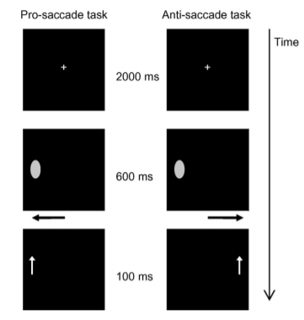
HA participants had longer correct antisaccade latencies than LA participants
Especially in threatening cues than positive or neutral ones

Slide 46
Teachers’ attention

Slide 47
Wolf et al. (2016). Teacher vision: Expert and novice teachers’ perception of problematic classroom management scenes. Instr Sci,44,243–265
Differences in how expert and novice teachers perceive problematic classroom scenes
Experienced and novice teachers
Viewing videos of authentic lessons

Slide 48
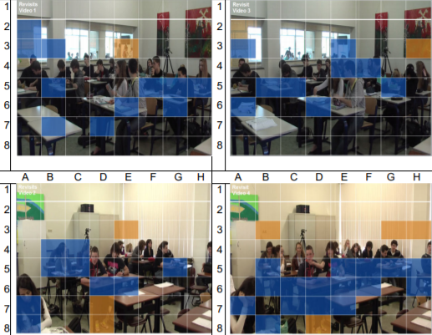
Expert teachers focused on areas with relevant information available
Novice teachers’ attention scattered across the classroom

Slide 49
Multimedia learning and Educational computer games

Slide 50
Multimedia learning Andresen et al. (2019). Processing and learning from multiple sources: A comparative case study of students with dyslexia working in a multiple source multimedia context. Frontline Learning Research, 7, 1–26.
How students with dyslexia process and integrate information in a multiple source multimedia context
10th-grade students with dyslexia
Eye-tracked while interacting with web-pages related to “Sunbathing and Health” including text, video, and picture
Follow-up interviews: watching the eye-movement videos and explaining the reasons for their processing pattern
Different strategy and processing patterns between participants
Integrating of text information was problematic

Slide 51
Educational Games Conati et al. (2013). Understanding Attention to Adaptive Hints in Educational Games: An Eye-Tracking Study. Int J Artif Intell Educ, 23, 136–161
Factors affecting student attention to user-adaptive hints in educational computer game (hint timing,prior knowledge, attitude towards help)
Attention patterns on the game adaptive-hints
Children Grades 5 and 6

Slide 52
Prime Climb
Number factorization game
Definitions: “Factors are..”
Tool : “Use magnifying glass..”
Bottom-out: “You fell because..”

Slide 53
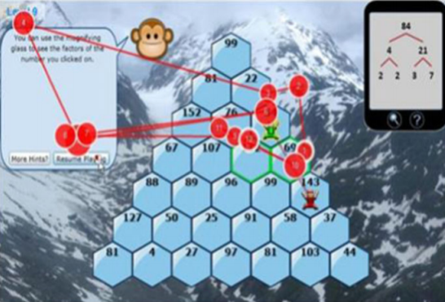
Why is eye-tracking better than hint-display time?
Eye-tracking measures: total fixation time, fixation per word, time to first fixation
Improved attention to hints is a worthwhile goal→ when they are attended to hints can positively affect a student’s performance with the game
e.g., definitions hints changes to more interesting and relevant

Slide 54
Eye-tracking as a tool

Slide 55
Simulated thalamic visual prostheses Rassia & Pezaris (2018). Improvement in reading performance through training with simulated thalamic visual prostheses. Nature, 8, 16310
Simulations of artificial vision
provide the researcher an opportunity to explore different aspects of visual prosthesis device

Slide 56
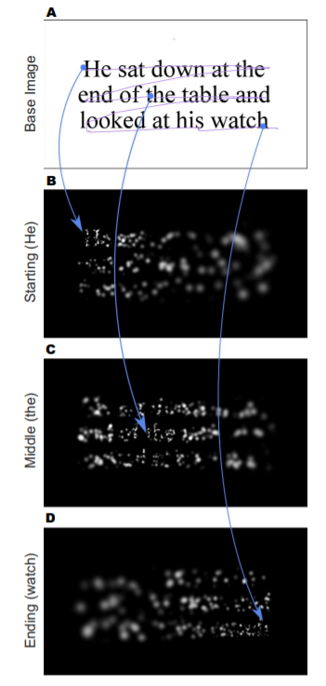

Slide 57
Pure Alexia (Letter-by-Letter Acquired Dyslexia ) Rayner & Johnson (2005). Letter-by-Letter Acquired Dyslexia Is Due to the Serial Encoding of Letters. Psychological Science, 16, 530–534.

Slide 58
Reading and Mathematics
Bolden, D., Barmby, P., Raine, S., & Gardner, M. (2015). How young children view mathematical representations: a study using eye-tracking technology. Educational Research, 57, 59–79
Hunt T. E., Clark-Carter, D., & Sheffield, D. (2015). Exploring the relationship between mathematics anxiety and performance: An Eye‐Tracking Approach. Applied Cognitive Psychology, 29, 226–231.
de Luca, M., Pontillo, M., Primativo, S., Spenelli, D., & Zoccolotti, P. (2013). The eye-voice lead during oral reading in developmental dyslexia. Frontiers in Human Neuroscience.
Penttinen, M., Huovinen, E., & Ylitalo, A-K. (2014). Reading ahead: Adult music students’ eye movements in temporally controlled performances of a children’s song. International Journal of Music Education, 33, 36-50
Rayner, K. (1998). Eye Movements in Reading and Information Processing: 20 Years of Research. Psychological Bulletin, 124, 372–422
Rayner, K. (2009). Eye movements and attention in reading, scene perception, and visual search. The Quarterly Journal of Experimental Psychology, 62, 1457–1506
Yan et al. (2013). Parafoveal processing efficiency in rapid automatized naming: A comparison between Chinese normal and dyslexic children. Journal of Experimental Child Psychology
van’t Noordende, J. E., van’t Noordende, A. H., & Scott, W. D. (2016). Number line estimation strategies in children with mathematical learning difficulties measured by eye tracking. Psychological Research, 80,368–378.
Attentional disengagement, social perception, and interaction
Chevallier, C., Parish-Morris, J., McVey, A., Rump, K. M., Sasson, N. J., Herrington, J. D., & Schultz, R. T. (2015). Measuring social attention and motivation in autism spectrum disorder using eye‐tracking: Stimulus type matters. Autism Res. , 620–628
Frost-Karlsson, M., Galazka, M. A., Gillberg, C., Gillberg, C., Miniscalco, C., Billstedt, E., Hadjikhani, N., & Åsberg Johnels, J. (2019). Social scene perception in autism spectrum disorder: An eye-tracking and pupillometric study. Journal of Clinical and Experimental Neuropsychology, 41, 1024–1032.
Sabatos-DeVito, M., Schipul, S. E., Bulluck, J. C., Belger, A., & Baranek, G. T. (2016). Eye Tracking Reveals Impaired Attentional Disengagement Associated with Sensory Response Patterns in Children with Autism. J Autism Dev Disord, 46, 1319–1333. doi: 10.1007/s10803-015-2681-5
Thorup, E., Nyström, P., Gredebäck, G., Sven Bölte, S., Falck-Ytter, T., & the EASE Team 2018). Reduced Alternating Gaze During Social Interaction in Infancy is Associated with Elevated Symptoms of Autism in Toddlerhood. Journal of Abnormal Child Psychology, 46, 1547–1561.

Slide 59
Hearing impairments
McMurray, B., Farris-Trimble, A., & Rigler, H. (2017). Waiting for lexical access: Cochlear implants or severely degraded input lead listeners to process speech less incrementally. Cognition, 169, 147-164.
Steel, M. M., Blake, C. P., & Gordon, K. A. (2015). Binaural Fusion and Listening Effort in Children Who Use Bilateral Cochlear Implants: A Psychoacoustic and Pupillometric Study. PlosOne, doi: 10.1371/journal.pone.0117611
Van Engen, K. J. & McLaoughlin, D. J. (2018). Eyes and ears: Using eye tracking and pupillometry to understand challenges to speech recognition. Hearing Research, 369, 56-66.
Wendt, D., Kollmeier, B., & Brand, T. (2015). How Hearing Impairment Affects Sentence Comprehension: Using Eye Fixations to Investigate the Duration of Speech Processing. Trends in Hearing, 19, 118.
Intellectual disabilities
Boot, F. H., Pel, J.J.M., Vermaak, M. P., van der Steen, J. & Evenhuis, H. M. (2013). Delayed visual orienting responses in children with developmental and/or intellectual disabilities. Journal of Intellectual Disability Research, 57, 1093–1103.
Vakil, E. & Lifshitz-Zehavi, H. (2012). Solving the Raven Progressive Matrices by adults with intellectual disability with/without Down syndrome: Different cognitive patterns as indicated by eye-movements. Research in Developmental Disabilities, 33,645-654.
Emotional Status
Harrisson, A. J. & Gibb, B. E. (2015). Attentional Biases in Currently Depressed Children: An Eye-Tracking Study of Biases in Sustained Attention to Emotional Stimuli. Journal of Clinical Child & Adolescent Psychology, 44, 1008–1014.
Derakshan, N., Ansari, T. L., Hansard, M., Shoker, L., & Eysenck, M. W. (2009). Anxiety, Inhibition, Efficiency, and Effectiveness: An Investigation Using the Antisaccade Task. Exp Psychol. , 56, 48–55.

Slide 60
Multimedia learning and Educational computer games
Andresen, A., Øistein, A., Salmerón, L., & Bråten, I. (2019). Processing and learning from multiple sources: A comparative case study of students with dyslexia working in a multiple source multimedia context. Frontline Learning Research, 7, 1–26.
Conati, C., Jaques, N., & Muir, M. (2013). Understanding Attention to Adaptive Hints in Educational Games: An Eye-Tracking Study. Int J Artif Intell Educ, 23, 136–161.
Teachers’ attention
Wolf, C. E., Jarodzka, H., van den Bogert, N., & Boshuizen, H. P. A. (2016). Teacher vision: expert and novice teachers’ perception of problematic classroom management scenes. Instr Sci,44,243–265.
Eye-tracking as a tool: Simulated thalamic visual prostheses
Rassia, E. K. & Pezaris, J. S. (2018). Improvement in reading performance through training with simulated thalamic visual prostheses. Nature, 8, 16310.
Rayner, K. & Johnson, R. L. (2005). Letter-by-Letter Acquired Dyslexia Is Due to the Serial Encoding of Letters. Psychological Science, 16, 530–534.

Slide 61
Thank you.

