Slide 1
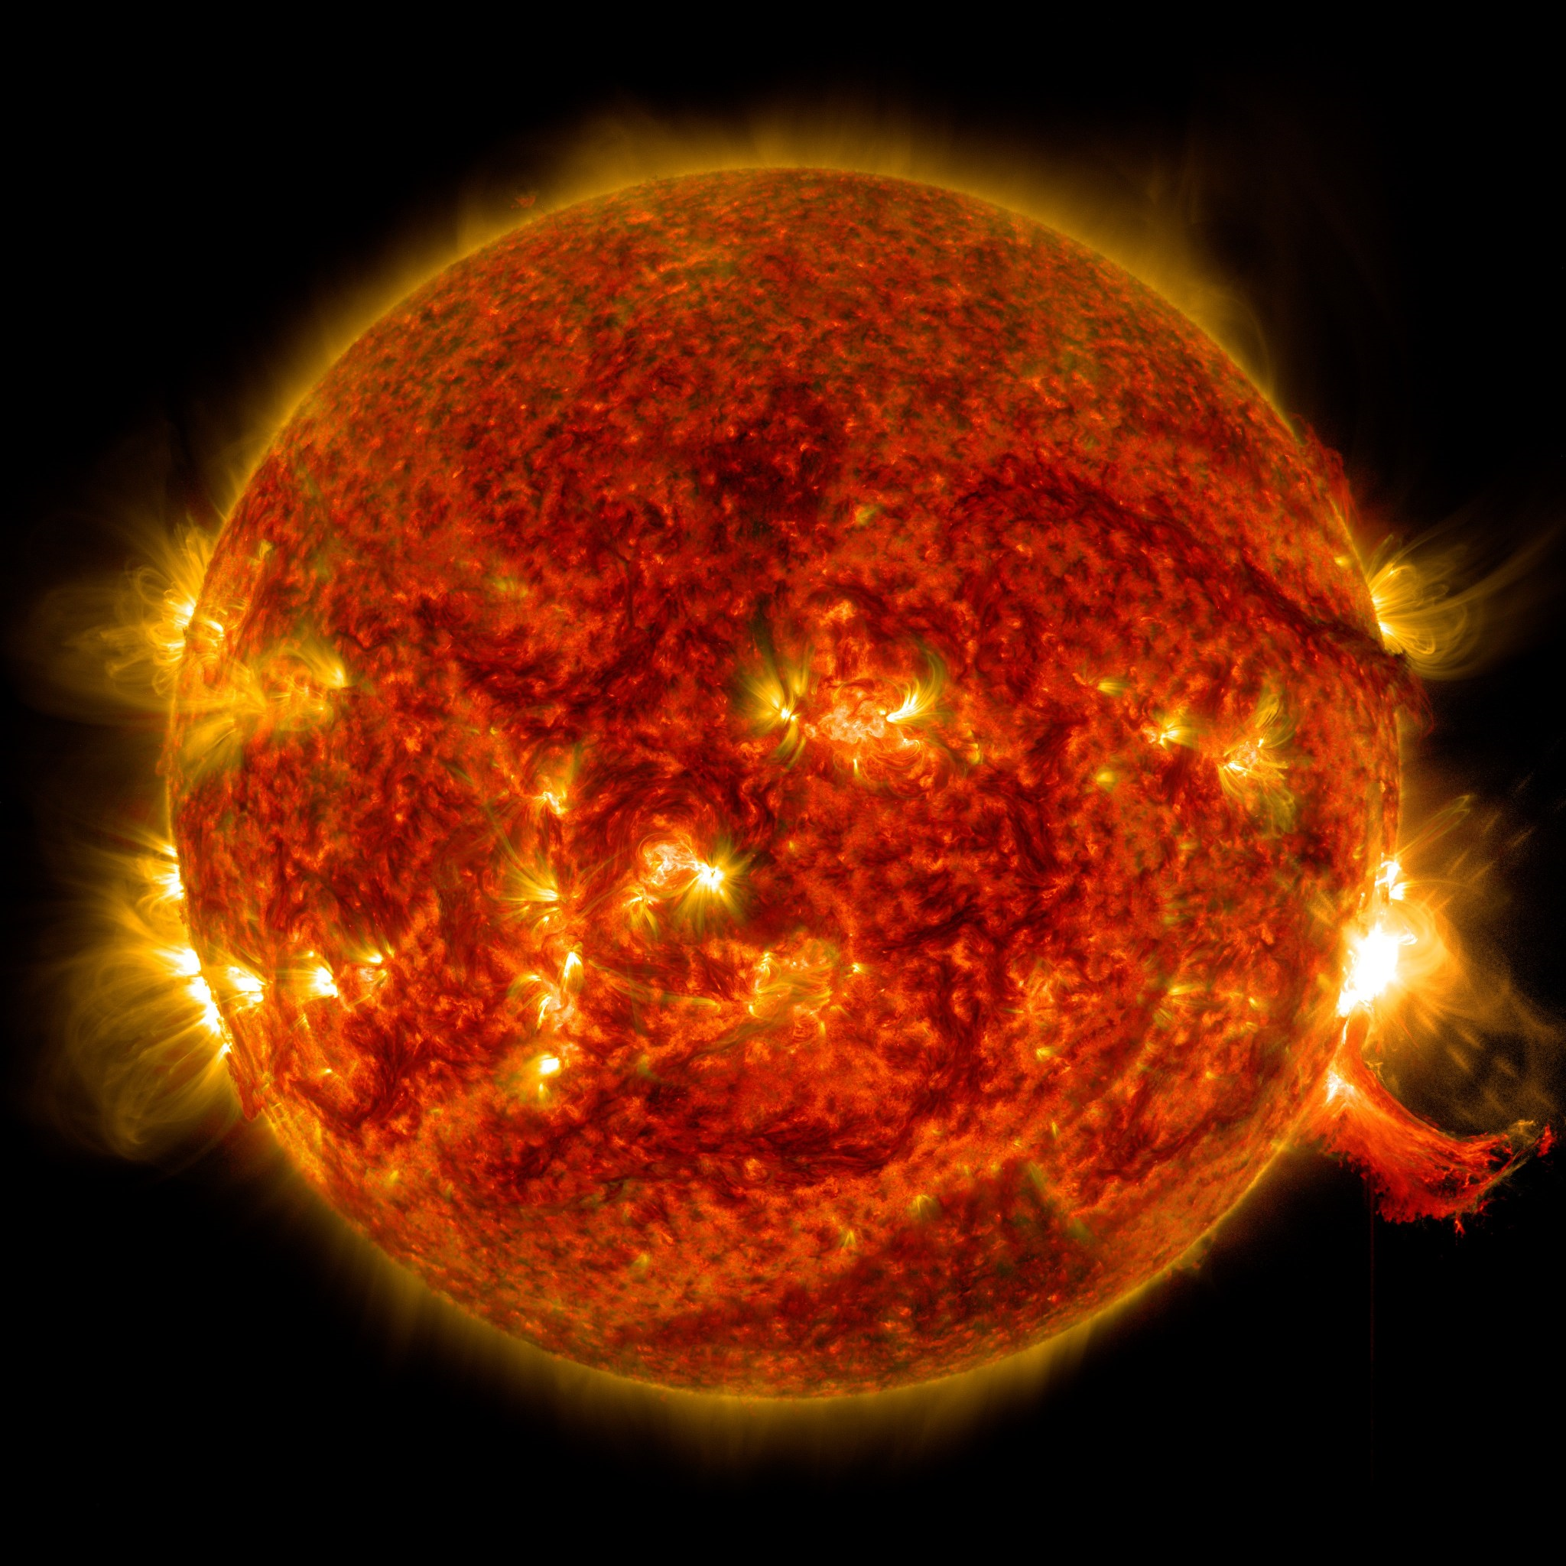
Impacts of coronal mass ejections (CMEs) on Satellite Technology
Magnus Carlom, Hilde Hemmos, Håvard Nesthun Tiner, Oda EggenRosenkilde, Rannveig Windingstadson og Anne-Ellen Skonnord
Notes:
Impacts of Sun Storms on Satellite Technology

Slide 2
Coronal mass ejections (CMEs)
Sun storms, also known as solar storms or space weather events, are disturbances in the Sun's atmosphere that release huge amounts of energy in the form of solar flares, coronal mass ejections (CMEs), and high-energy particles.
THESE STORMS OCCUR DUE TO MAGNETIC ACTIVITY ON THE SUN'S SURFACE
specifically in the Sun's outer layer called the corona.
ORBIT DISRUPTIONS AND SATELLITE COLLISIONS
Solar storms heat Earth's upper atmosphere, causing it to expand. The increased atmospheric drag on low-Earth orbit satellites can alter their orbital paths and speed.
This can lead to unexpected orbital decay, potentially causing uncontrolled re-entry or increasing the possibility of collisions with other satellites or space debris.
16.04.24
shanecol@uv.uio.no
2

Slide 3
Sun storms can damage satellites in several ways:
Solar flares release intense radiation, including X-rays and ultraviolet (UV) rays, which can interfere with satellite communication systems, disrupt radio signals, and cause temporary blackouts in satellite transmissions.
Coronal mass ejections (CMEs) are massive eruptions of plasma and magnetic field from the Sun's corona. When CMEs collide with satellites, they can induce powerful electrical currents that overload and damage sensitive electronics onboard.
CMEs Effects on Satellites
High-energy particles, also known as solar energetic particles (SEPs), can penetrate satellite materials, causing electronic malfunctions and even permanent damage.
16.04.24
shanecol@uv.uio.no
3

Slide 4
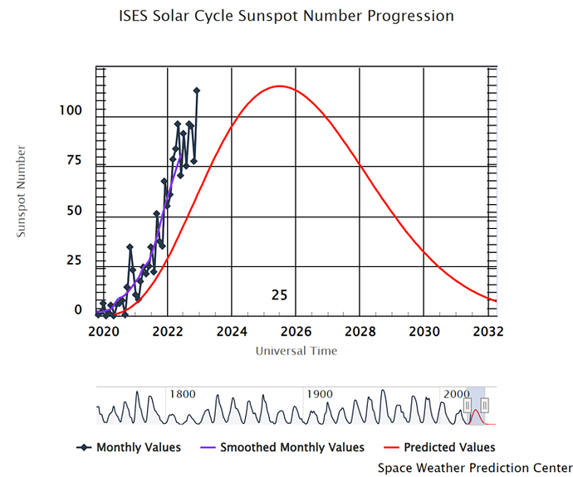
Modeling Solar Wind and CMEs
Predictions for solar cycle 25 have varied widely, ranging from a very weak cycle hinting at a Maunder-like minimum state to a strong cycle similar to the previous cycle 24.
Upton and Hathaway suggested that cycle 25 would contribute to a Modern Gleissberg Minimum. The Solar Cycle 25 Prediction Panel, in December 2019, forecasted that cycle 25 would resemble cycle 24, with a sunspot maximum of 115 expected in July 2025.
This aligns with the consensus that cycle 25 will be weaker than average. However, early observations from 2020 to 2022 have surpassed these predictions.
16.04.24
shanecol@uv.uio.no
4

Slide 5
CMEs blast billions of tons of solar plasma, composed of electrons and protons, into space at speeds ranging from 250 kilometers per second to as high as 3000 kilometers per second.
About 1 in 3 CMEs that hit Earth causes significant geomagnetic storming, which can lead to satellite anomalies such as temporary malfunctions, permanent damage, or even complete satellite failure.
The economic impact of a severe space weather event could be significant. A 2013 study by the Lloyd's of London insurance market estimated that space weather could have a total economic cost of up to $2.6 trillion worldwide.
CMEs Effects on Satellites
Impact & probability
D. Odstrcil et al. (2003) (see also Kjensli et al. 2007)
16.04.24
shanecol@uv.uio.no
5
Notes:
1. That's almost 1% of the speed of light!

Slide 6
Forecasting Solar Storms and Sun Observation
Solar Observatories: Monitoring the Sun's activities through telescopes and satellites to observe changes in solar activity and identify potential storms.
Solar Flare Detection: Analyzing sudden releases of magnetic energy on the Sun's surface to forecast powerful solar flares that can cause disruptions on Earth.
Coronal Mass Ejections (CMEs): Tracking the ejection of massive amounts of plasma and magnetic fields from the Sun's atmosphere to predict the arrival time and intensity of CMEs.
Space Weather Models: Utilizing computer models that integrate solar observations and historical data to forecast the impact of solar storms on Earth's magnetosphere, ionosphere, and technological systems.
16.04.24
shanecol@uv.uio.no
6

Slide 7
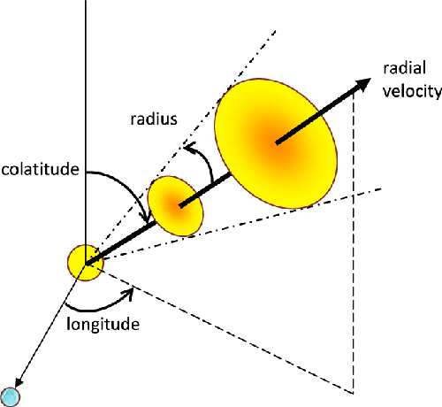
Modeling Solar Wind and CMEs
WSA model predicts coronal conditions and maps background solar wind based on magnetic flux-tube expansion
Cone tool estimates initial CME parameters from white-light coronagraph images and integrates them into WSA-ENLIL for evolution with background solar wind
ENLIL uses hydrodynamic ejecta to simulate CMEs without magnetic-cloud structure initially, allowing for modification of CME parameters to match in situ observations
CMEs are integrated into the ENLIL numerical grid along with the background solar wind conditions, allowing for acceleration or deceleration based on the evolution of the solar wind.
16.04.24
shanecol@uv.uio.no
7

Slide 8
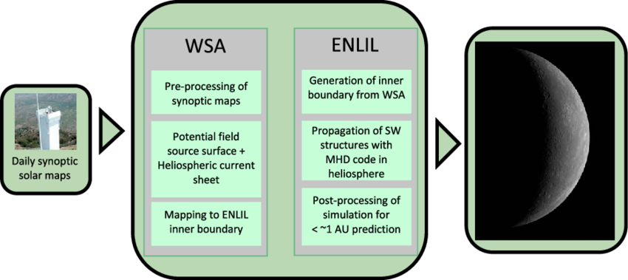
Modeling Solar Wind and CMEs
16.04.24
shanecol@uv.uio.no
8
Notes:
To simulate the total solar wind in the inner heliosphere, we used a series of coupled empirical and numerical models in which we treated the corona and heliosphere separately. The Wang-Sheeley-Arge (WSA) model predicts coronal conditions and allows for the eventual mapping of the background solar wind. An extension of the original Wang and Sheeley [1992] model, WSA is a semiempirical model based on magnetic flux-tube expansion [Arge and Pizzo, 2000]. The model uses magnetic synoptic maps of the solar surface as input to a potential field source surface (PFSS) model that provides an estimate of current sheet properties [Schatten et al., 1969]. The PFSS model is predicated on the assumption that the corona is current-free between the photosphere and 2.5 Rsun, beyond which the plasma controls the magnetic field, where Rsun is the solar radius. At 2.5 Rsun, all magnetic field lines are constrained to be open and radial, and the magnetic field is computed from a scalar potential that obeys Laplace’s equation. With empirical relationships for magnetic flux-tube expansion, the model initializes the solar wind flow by propagating the plasma-controlled current sheet properties to 21.5 Rsun. These WSA outer boundary conditions become the inner boundary conditions for the heliospheric model ENLIL (Figure 1).

Slide 9
Indicators and Modeled Solar Wind Parameters
WSA model predicts coronal conditions and maps background solar wind based on magnetic flux-tube expansion
Cone tool estimates initial CME parameters from white-light coronagraph images and integrates them into WSA-ENLIL for evolution with background solar wind
ENLIL uses hydrodynamic ejecta to simulate CMEs without magnetic-cloud structure initially, allowing for modification of CME parameters to match in situ observations
CMEs are integrated into the ENLIL numerical grid along with the background solar wind conditions, allowing for acceleration or deceleration based on the evolution of the solar wind.
16.04.24
shanecol@uv.uio.no
9
Notes:
file:///C:/Users/mariaepi/Downloads/Dewey_et_al-2015-Journal_of_Geophysical_Research__Space_Physics.pdf

Slide 10
Plasma Properties Relevant for Turbulence Studies
Using the 1963–2017 OMNI2 data set, the occurrence distributions of six plasma properties are binned for the four different types of solar wind plasma: (a) the speed of the solar wind, (b) the Alfvén speed in the solar wind plasma, (c) the Alfvén Mach number of the solar wind, (d) the age of the plasma at 1 AU, (e) the logarithm of the proton beta of the plasma, and (f) the angle between the 1‐hr‐average magnetic field vector and the radial direction.

Slide 11
MINOS and MINOS+ Beam

